Slide 1

Green Pace
Security Policy Presentation
Developer: Mac Grier

Slide 2

OVERVIEW: DEFENSE IN DEPTH

Slide 3
THREATS MATRIX
Likely STR-002-C MEM-050-CPP ERR-051-CPP EXP-050-CPP | Priority STD-001-CPP EXP-053-CPP STR-002-C MEM-050-CPP MSC-050-CPP
Low priority INT-050-CPP DCL-003-CPP ERR-051-CPP MSC-052-CPP EXP-050-CPP | Unlikely STD-001-CPP INT-050-CPP EXP-053-CPP DCL-003-CPP MSC-050-CPP MSC-052-CPP

Slide 4
10 PRINCIPLES
Validate Input Data
  INT-050-CPP, STR-053-CPP, STR-002-C,
Heed Compiler Warnings
  EXP-053-CPP, DLC-003-CPP, MSC-052-CPP, EXP-050-CPP
Architect and Design for Security Policies
  ERR-051-CPP, MSC-050-CPP,
Keep It Simple
  MEM-050-CPP, EXP-050-CPP
Default Deny
  EXP-053-CPP
Adhere to the Principle of Least Privilege
  STR-002-CPP
Sanitize Data Sent to Other Systems
  STR-002-C,
Practice Defense in Depth
  STR-053-CPP, STR-002-C, ERR-051-CPP,
Use Effective Quality Assurance Techniques
  INT-050-CPP, EXP-053-CPP, STR-053-CPP, MEM-050-CPP, DLC-003-CPP, ERR-051-CPP, MSC-050-CPP, MSC-052-CPP, EXP-050-CPP
Adopt a Secure Coding Standard
  INT-050-CPP, EXP-053-CPP, STR-053-CPP, STR-002-C, MEM-050-CPP, DLC-003-CPP, ERR-051-CPP, MSC-050-CPP, MSC-052-CPP, EXP-050-CPP

Slide 5
CODING STANDARDS
Sanitize data passed to complex subsystems.
Do not access freed memory
Do not read uninitialized memory.
Do not depend on the order of evaluation for side effects.
Range check element access
Do not use std::rand() for generating pseudorandom numbers
Do not cast to an out-of-range enumeration.
Handle all exceptions
Value-returning functions must return a value from all exit paths
Use a static assertion to test the value of a constant expression

Slide 6
ENCRYPTION POLICIES
Encryption at Rest
  Stored data is considered at rest and needs to be encrypted. Doing this insures that in the event of the data being stolen it is incredibly hard or impossible to read it.
Encryption at Flight
  Data that is being communicated through a network or the web is considered at flight. That data must be encrypted, and a secure channel must be established between the sender and the recipient client that confirms identities and transmits encryption methods so that the recipient can decrypt the data.
Encryption in Use
  Data that is being actively used in operations is considered in use. While it is in use, encryption still needs to be done to secure the data in case it is exposed and intercepted. Encryption techniques should be employed even if they slow down operations.

Slide 7
TRIPLE-A POLICIES
Authentication
  Users are identified typically through a login system. Identifying users is important to ensure that data is not accessed improperly and lost, altered, or stolen.
Authorization
  What actions a user can take and what data they can access based on a set of permissions or roles. Those permissions or roles decide for example if a user can read a file or delete it.
Accounting
  Tracking the actions of users is done both for system security and for maintenance. User activity like login attempts, data accessed, and commands ran are recorded and can be accessed by administrators and system auditors.

Slide 8
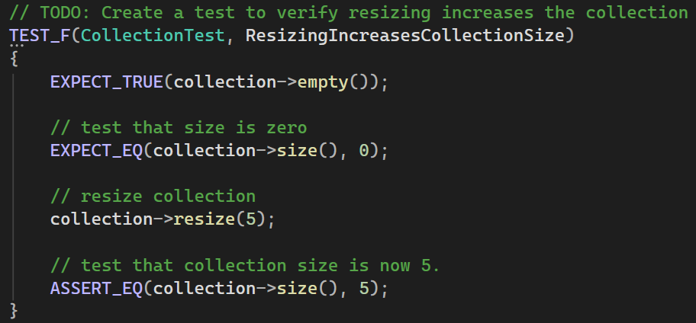
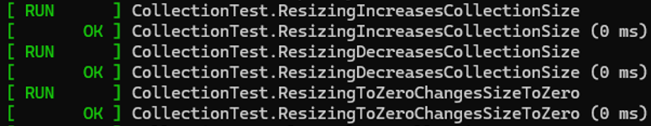
Unit Testing
Resizing Increases Collection Size:

Slide 9
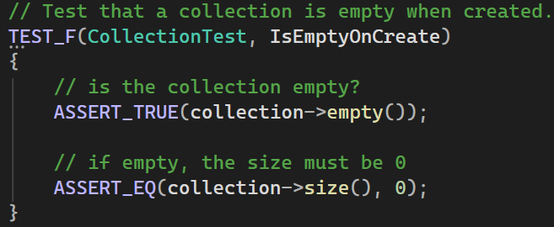
Unit Testing
Empty on Create:

Slide 10
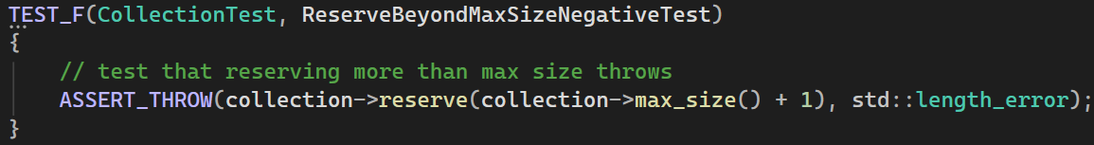
Unit Testing
Reserve Beyond Max Size:

Slide 11
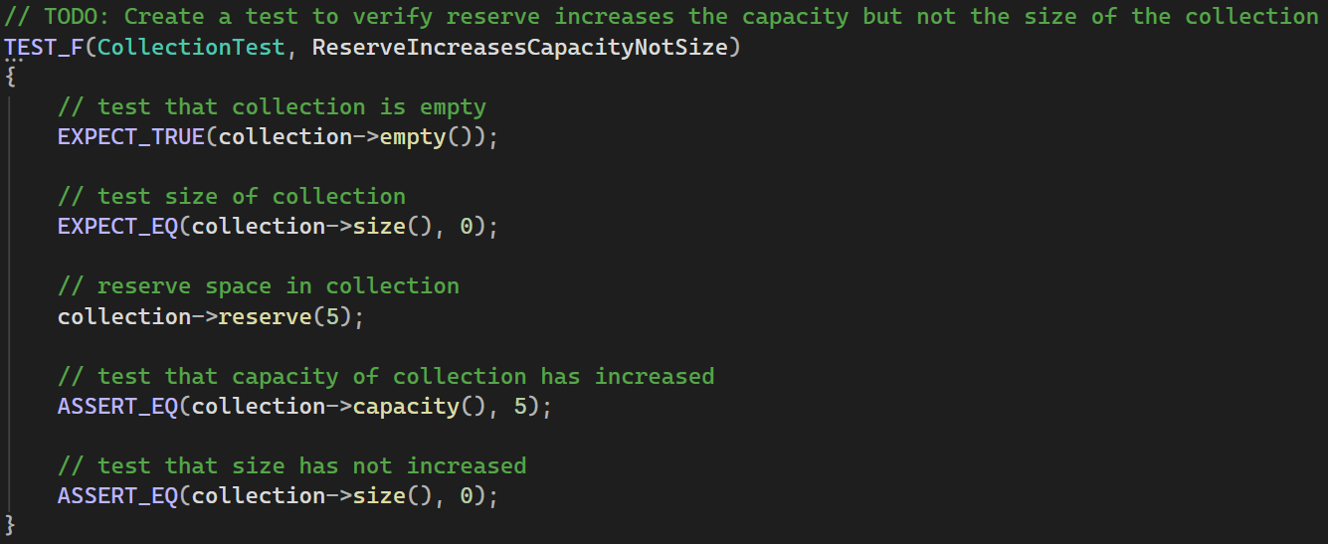
Unit Testing
Reserve Increases Capacity Not Size:

Slide 12

AUTOMATION SUMMARY

Slide 13
TOOLS
  The DevSecOps pipeline uses tools throughout development
    In preproduction, the pipeline has steps to design and test
    In production, the pipeline has steps for implementing, monitoring, and maintaining the software
  Tools Used:
    Jenkins: CI/CD pipeline https://www.jenkins.io/doc/book/pipeline/
    Clang: Compiler front-end https://clang-analyzer.llvm.org/
    CPPCheck: Static code analysis tool https://cppcheck.sourceforge.io/manual.html
    GoogleTest: Unit tests for C++ https://github.com/google/googletest
    OWASP: Application security testing: https://owasp.org/

Slide 14
RISKS AND BENEFITS
  Example:
  Marriott International database hack
  Date Discovered:
  September 8, 2018
  Cost:
  $276,000,000+ and was forced to implement a strict third party enforced cybersecurity program.
Should we act now?
Implementing security needs to happen
in the design and planning stage
Risks:
  Harm to customers
  Harm to consumer sentiment
  Liability for damages
  Fines for lack of mitigation practices
Benefits:
  Mitigates risk of damage
  Easier to implement
  Know about security gaps
  before they become an issue

Slide 15
RECOMMENDATIONS
    Train developers to understand best practices and principles
    Implement DevSecOps pipeline
    Add automation to the pipeline to improve security
    Regularly review and update security plans

Slide 16
CONCLUSIONS
Security must be a focus from day one of development
Reinforce security implementation with automatic checks that halt deployment if they fail
Standards and principles should be taught and developed with in mind
The benefits of acting immediately greatly outweigh the costs

Slide 17
REFERENCES
Fruhlinger, J. (2020, February 12). Marriott Data breach FAQ: How did it happen and what was the impact?. CSO Online. https://www.csoonline.com/article/567795/marriott-data-breach-faq-how-did-it-happen-and-what-was-the-impact.html

